Slide 1
Solving Overfitting in Neural Network
J.S Kim
2021.05.25

Slide 2
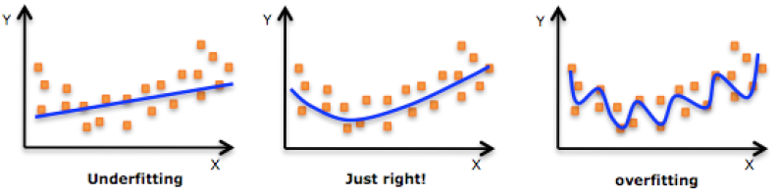
Overfitting
Overfitting: The production of analysis that corresponds too closely or exactly to a particular data(=Training sets) and therefore, fail to fit additional data or predict test data reliably.
Matrix Form
Complexity: low
Sample bias: low
Complexity: High
Sample bias: High

Slide 3
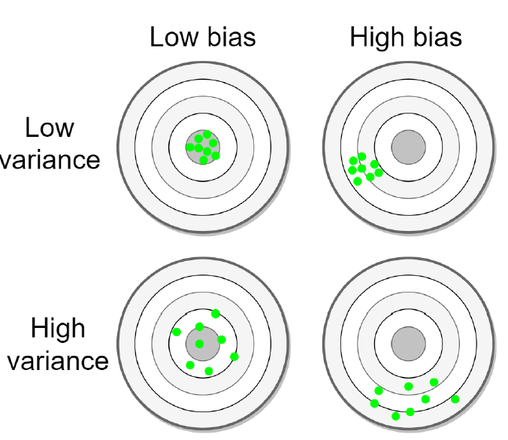
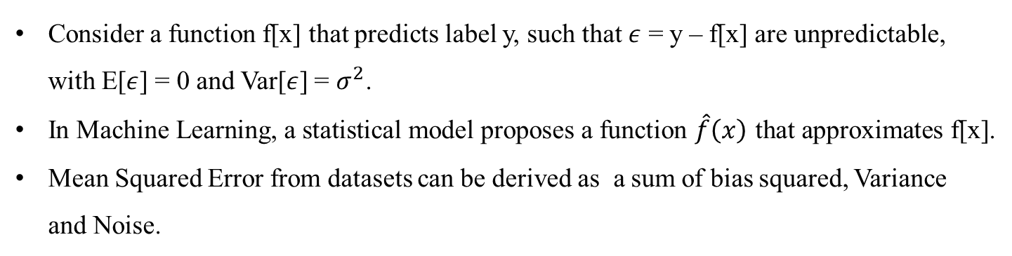
Overfitting
Consider a function f[x] that predicts label y, such that $ε$ = y – f[x] are unpredictable, with E[$ε$] = 0 and Var[$ε$] = $σ^{2}$.
In Machine Learning, a statistical model proposes a function $\hat{f}\left(x\right)$ that approximates f[x].
Mean Squared Error from datasets can be derived as a sum of bias squared, Variance and Noise.
${E[(y−\hat{f}\left(x\right)}^{2}$)] = ${E[(f(x)−\hat{f}\left(x\right))}^{2}$] + ${V[\hat{f}\left(x\right)}^{}$] + V[$ε]$
Bias Squared
Variance
Noise
★Noise: caused by datasets

Slide 4
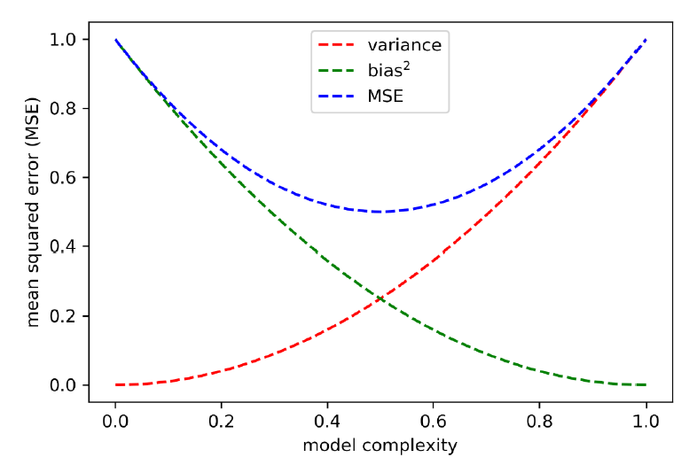
Overfitting
- Bias occurs when $\hat{f}\left(x\right)$ underfits the data, the model confounds signal for noise.
- Variance occurs when $\hat{f}\left(x\right)$ overfits the data, the model confounds noise for signal.
Bias Squared
Variance
Noise
${E[(y−\hat{f}\left(x\right)}^{2}$)] = ${E[(f(x)−\hat{f}\left(x\right))}^{2}$] + ${V[\hat{f}\left(x\right)}^{}$] + V[$ε]$

Slide 5
Overfitting
In general, bias can only be reduced at the expense of increasing Variance.
Overfitting causes model Variance, because a model overfit on one set does not generalize well outside that set.
A good statistical model minimizes the loss by finding the optimal balance between bias and variance.
Optimal condition

Slide 6
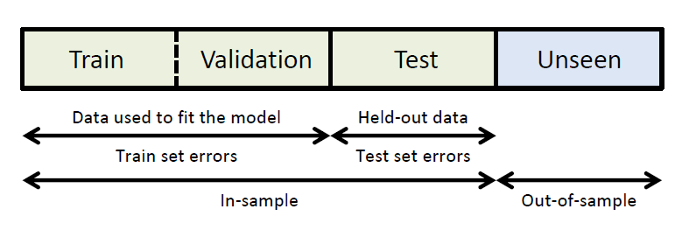
Overfitting
Train set: used to select features and fit model parameters
Valid set: used to find the optimal hyper-parameters
Test set: Hold-out data, not used for fitting the model
(Purpose) Estimate two in-sample Errors: Train set Errors + Test set Errors
Overfitting can occur when we try to minimize one or both of these errors

Slide 7
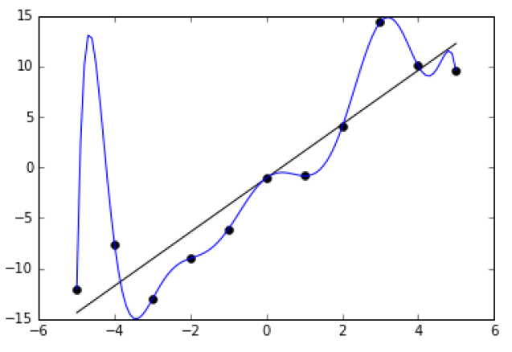
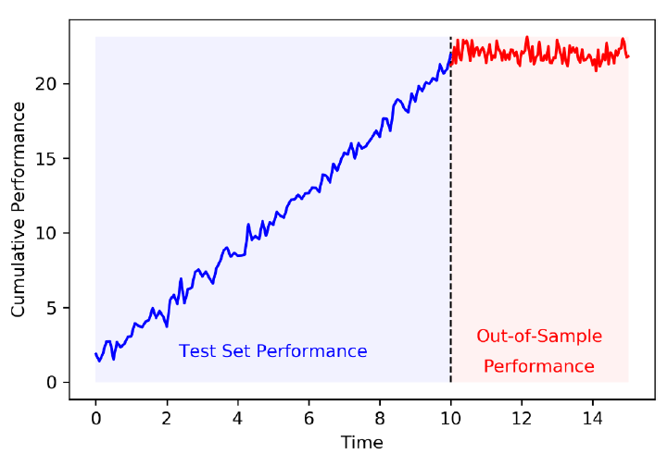
Overfitting
Train Set Overfitting
Test Set Overfitting
Occurs when…
a model is chosen to minimize train set errors.
At the expense of higher variance on test set errors
Related to model Complextiy. Overcomplextiy attempts to fit signal, but it ends up fitting noise.
Diagnosed by estimating the generalization error on the test set via resampling methods(cross validation) or Monte Carlo method.
Getting more data and simplifying the model can be a solution
Occurs when…
a model is chosen to minimize test set errors.
At the expense of higher out –of-sample variance.
Related to selection bias under multiple testing.
Diagnosed by estimating the generalization error on unseen data(out-of-sample)
Starting all over with new dataset and adjusting the probability of a false positive can be a solution.

Slide 8
Overfitting
Simpler Architecture
Data Augmentation
Early Stopping
Dropout
Regularization

Slide 9
Data Augmentation
Pitch shifting
Time stretching
Adding background noise
Librosa
librosa.effects.time_stretch(y, rate, kwags)
librosa.effects.pitch_shift(y, sr, n_steps, bins_per_octave)

Slide 10
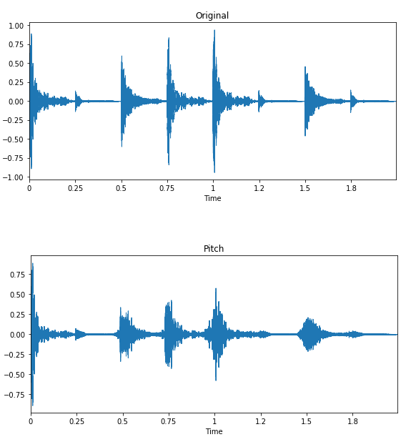
Data Augmentation
Pitch shifting
- Process of changing the pitch without affecting the speed

Slide 11
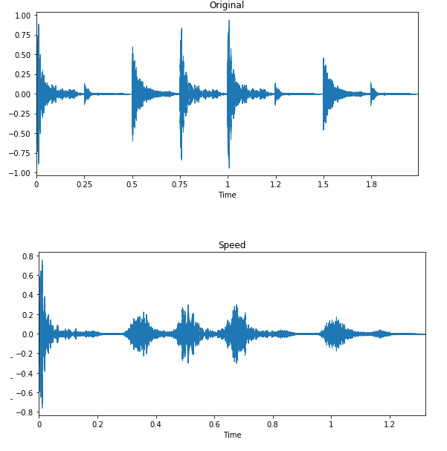
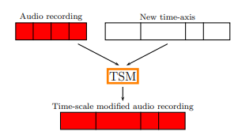
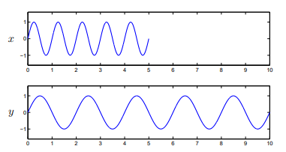
Data Augmentation
Time stretching
- Process of changing the speed of duration of an audio signal without affecting its pitch.
Notes:
Pitch: 사람이 주관적으로 듣고 판단하는 음의 높낮이
Freq: 측정 가능한, osciliating frequency, 높을수록 고음

Slide 12
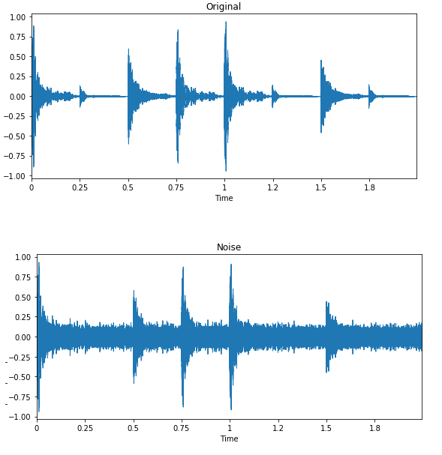
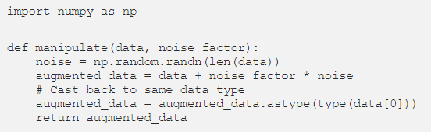
Data Augmentation
Adding background noise

Slide 13
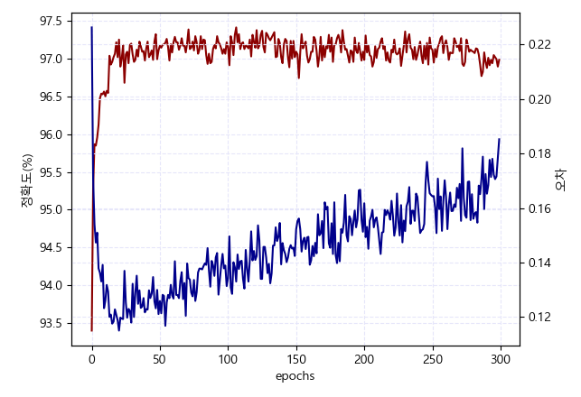




Early Stopping
Early Stopping
: Total loss
: Empirical loss
Bias – Variance Tradeoff :
Bias
Variance

Slide 14
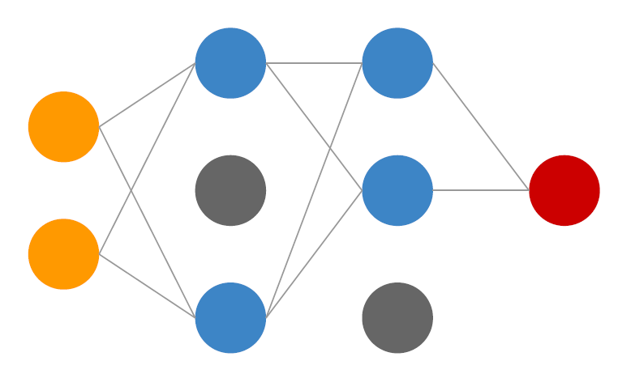
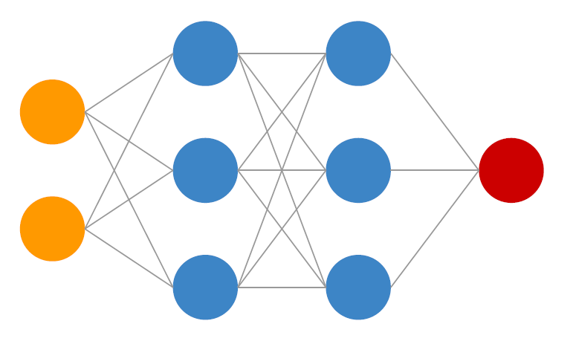
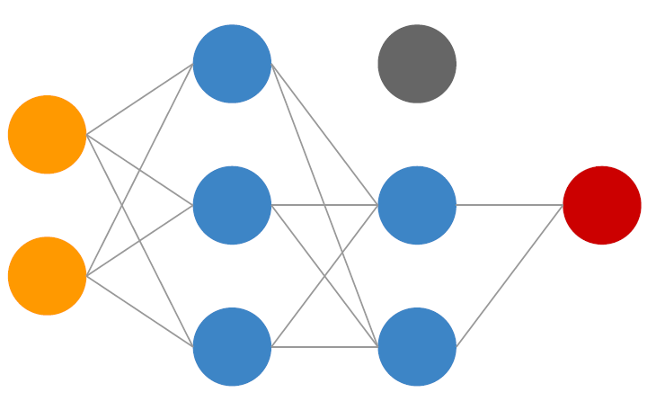
Dropout
Randomly drop neurons while training.
Increase Network Robustness
Dropout process causes every epoch with batch size data for training.
Prevent co-adaptation and overfitting.

Slide 15


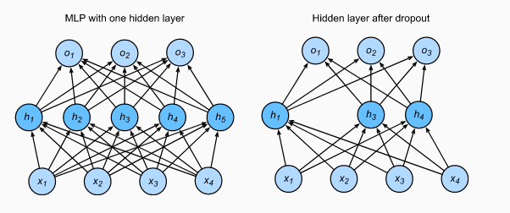
Dropout
In the case of probability p
Otherwise
Co-adaptation:
increasing dependency of specific neural(=nodes) from other nodes during training process.
Dropout prevent increasing dependency of nodes with high weight value by ignoring the nodes randomly.
Network can be more robustness: non-affectable for specific training datasets.

Slide 16
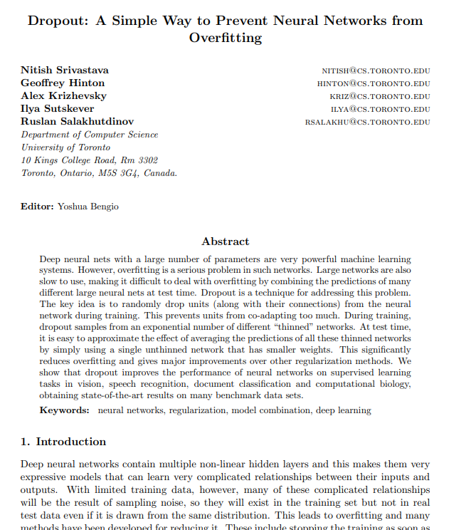
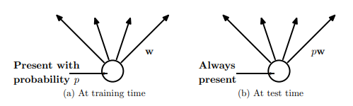
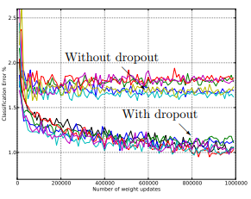
Dropout

Slide 17
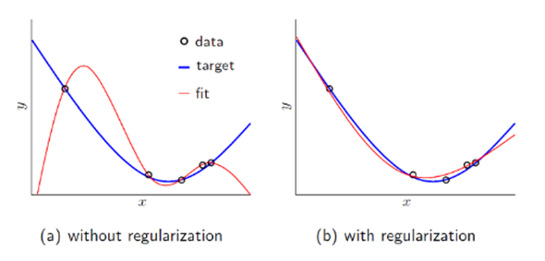
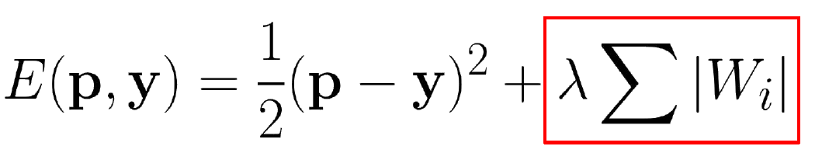
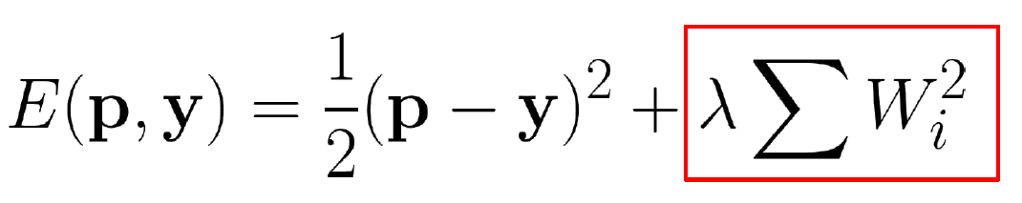



Regularization
L1 Regularization(Lasso)
L2 Regularization(Ridge)
$w←w − η\frac{∂E}{∂w} −λ sgn⁡(w)$
for L1 regularizer
Forward: $E(p,y)$ from n-epoch
$$w←(1−2λ)w − η\frac{∂E}{∂w}$$
for L2 regularizer
Backward process

Slide 18
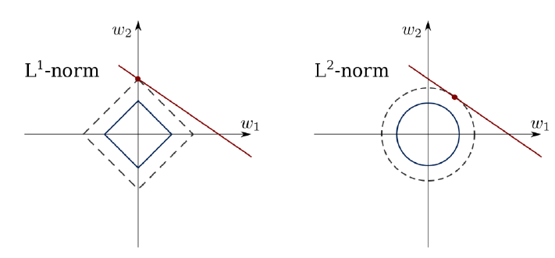
Regularization

Slide 19
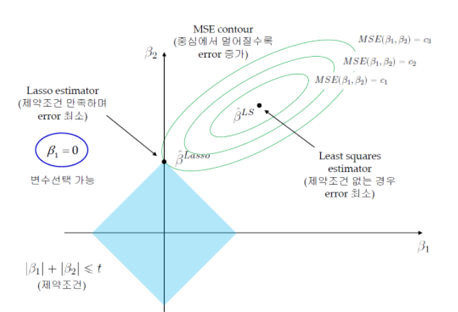
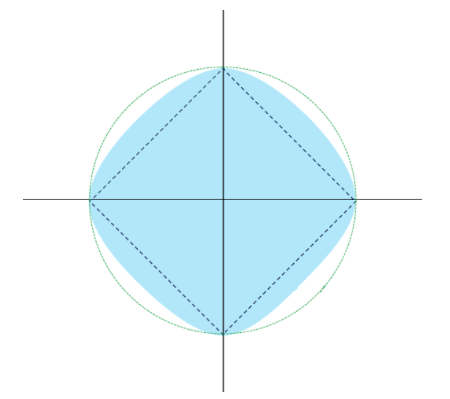
Regularization
L1, L2 Regularization

Slide 20
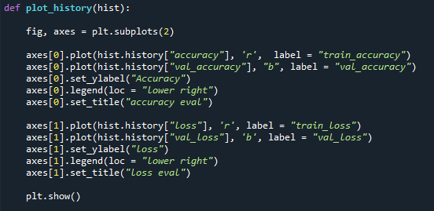
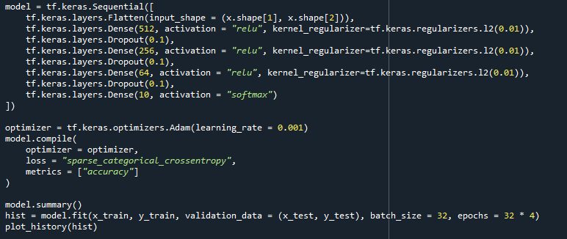
Code Analysis
Using Dropout and L2 Regularizer

Slide 21
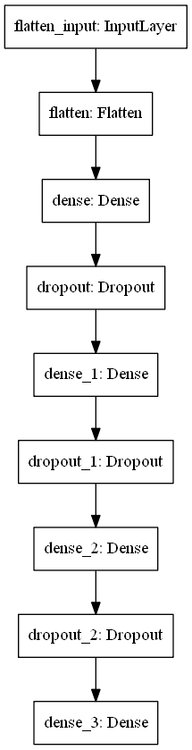
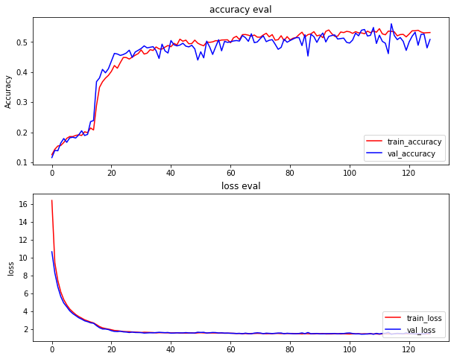
Code Analysis

Slide 22
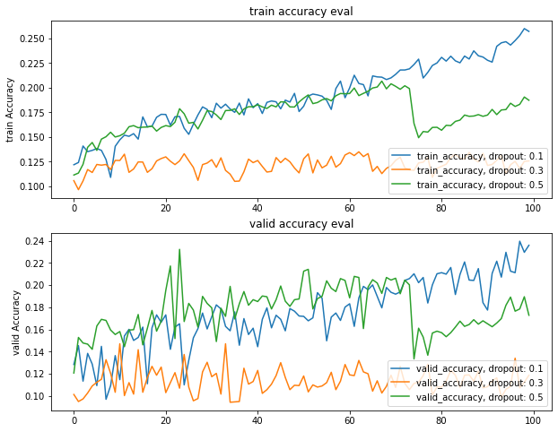
Code Analysis

Slide 23
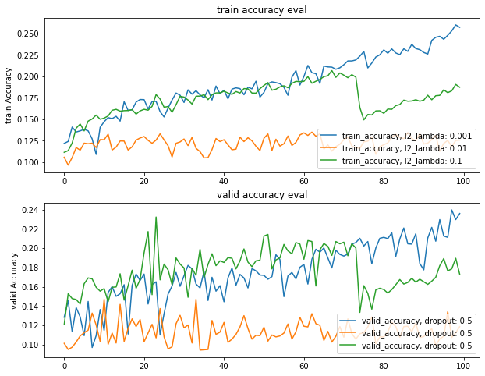
Code Analysis

Slide 24
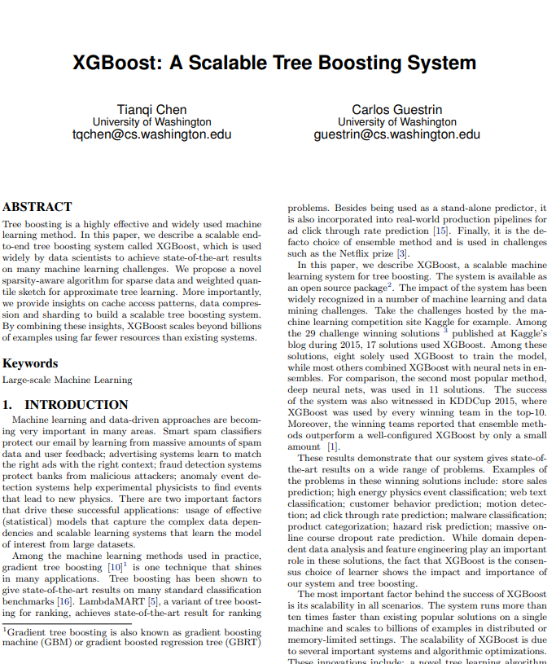
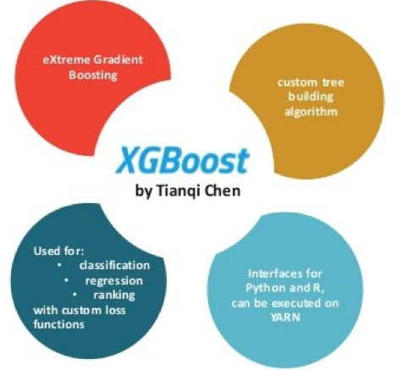
xgboost
Xgboost: Extream Gradient Boosting
Method: Gradient Boosting + CART model + parallel computing
Used for Supervised Learning

Slide 25
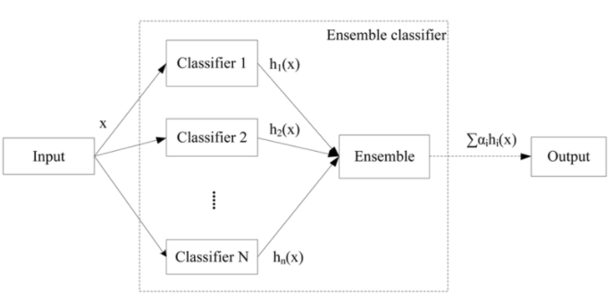
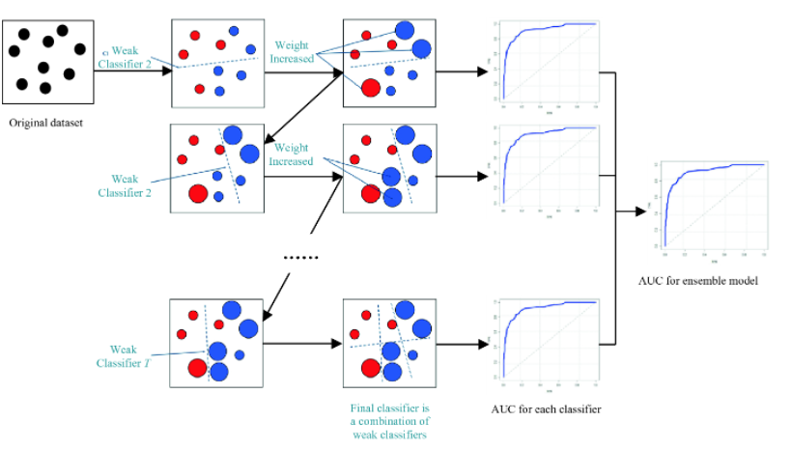
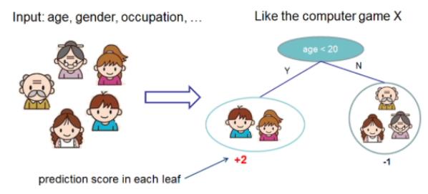
xgboost
End – to – End tree boosting system
Novel tree learning algorithms: Sparse data handling
Scalable, Flexible, custom evaluation can be used for every situation
Greedy-algorithm: Probability of causing overfitting low
Model Structure: Ensemble(multi-model)+ (Gradient) Boosting + CART
Ensemble
Gradient Boosting
CART

Slide 26
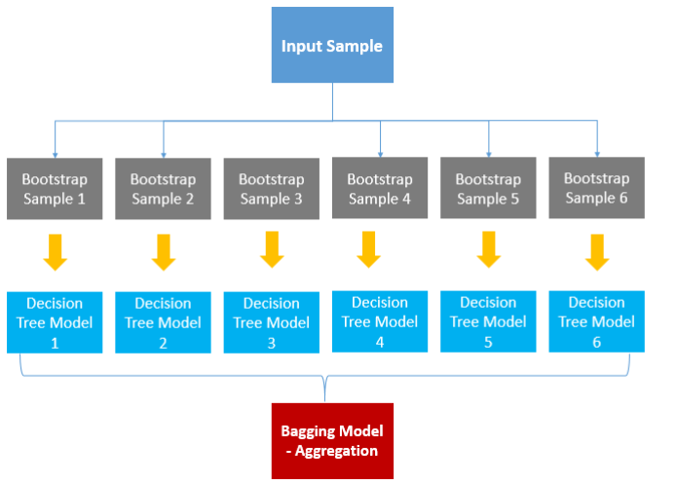
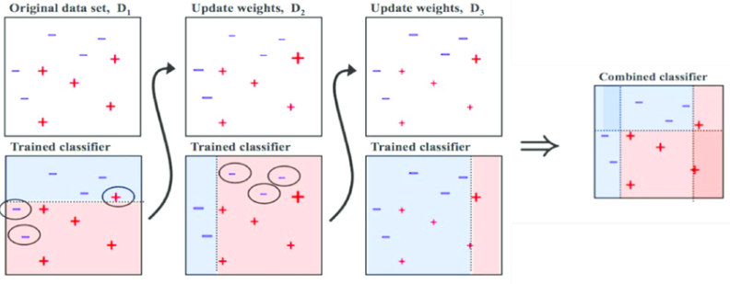
xgboost
Bagging and Boosting
Bagging: Boostrap Aggregation, uniform sampling for whole datasets and prediction by voting
Boosting: Training several weak learners by common datasets with different weights
Bagging
Boosting

Slide 27
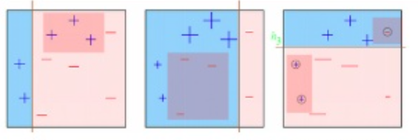
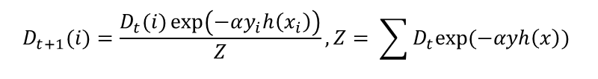
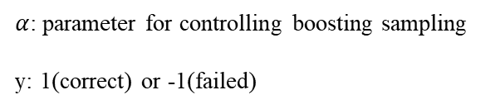


xgboost
Gradient Boosting
Update weights by calculating cost function and using gradient descent(classification:error)
D1
D2
D3
$$model error (ε)= \frac{error data}{total data}$$
$$α= \frac{1}{2} ln⁡(\frac{1−ε}{∈})$$
$α$: parameter for controlling boosting sampling
y: 1(correct) or -1(failed)
$$D_{t+1}(i)=\frac{D_{t}(i)\exp\left(−αy_{i}h\left(x_{i}\right)\right)}{Z}, Z= \sum{D_{t}exp⁡(−αyh\left(x\right))}$$

Slide 28

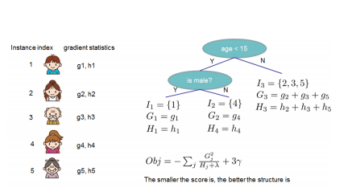
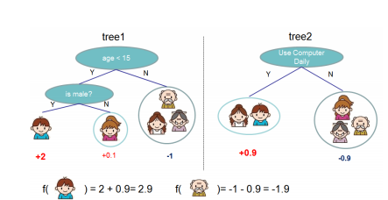
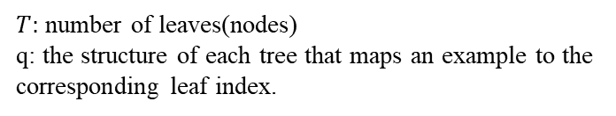
xgboost
Tree Learning Algorithms
Regularized Learning Objective: training functional sets with regularized objective function
$T:$ number of leaves(nodes)
q: the structure of each tree that maps an example to the corresponding leaf index.

Slide 29
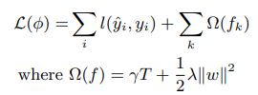



xgboost
Tree Learning Algorithms
l is a differentiable convex loss function that measures the difference between the prediction and target.
$T:$ number of leaves(nodes)
Lamdba: L2 parameter

Slide 30
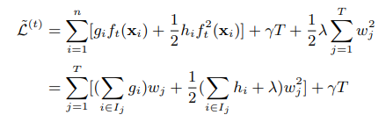



xgboost
$$optimized..$$

